Slide 1
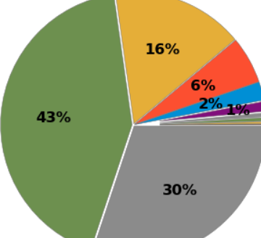
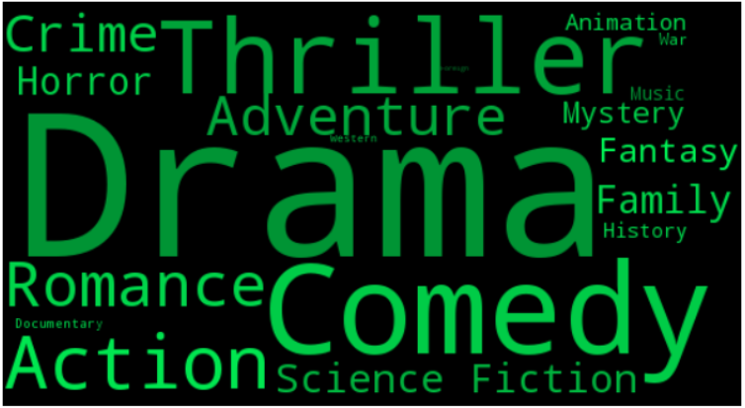
1.Data source:
https://www.kaggle.com/fabiendaniel/categorizing-actors-hands-on-plotly
2.Question:
Which genre of movies is the most popular?
What kind of words are using most on movies?
What are features of the most popular actors?
3.Module:
Pandas, Matplotlib.pyplot, Plotly, Numpy.
4.Visualization types:
Pie chart, Map, Scatter diagram...

